Slide 1
Cambridge Executive Leadership Programme
Media Strategy & Campaign Plan
Construct Digital / March 2025

Slide 3
Recommended Channel Mix
LinkedIn + Google Strategy

Slide 4
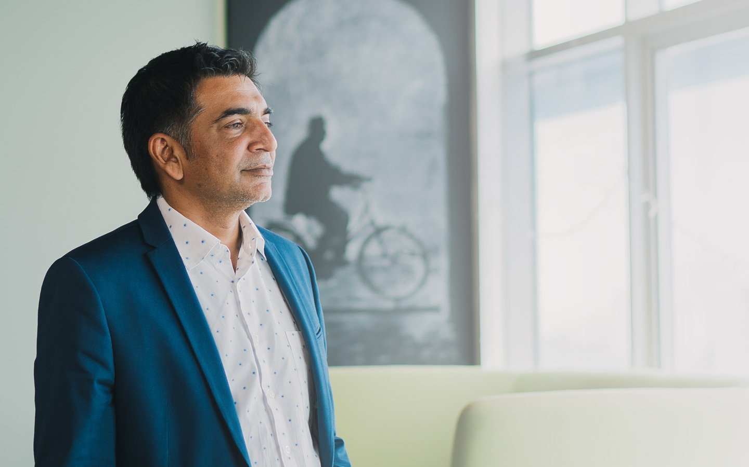
Campaign Flow
Tactical Architecture

Slide 6


Slide 7
Media Plan & Forecast
4-Month Campaign Performance

Slide 8
Campaign Overview
Strategic Context & Objectives

Slide 9
Audience Segmentation
Who We're Reaching

Slide 10
Conversion Funnel Architecture
3-Stage Lead Journey

Slide 11
Messaging Structure
Awareness → Consideration → Conversion

Slide 12
Primary Persona
C-suite executives (40-55) managing P&L
Gain board-level credibility
Build Asia-Pacific peer network
Acquire actionable strategy frameworks

Slide 13
Secondary Persona
Senior directors (35-50) for C-suite advancement
Accelerate promotion trajectory
Close leadership skill gaps
Justify employer sponsorship

Slide 14
Conversion Funnel
STAGE 1: Prospecting (60%)
Capture executive attention via LinkedIn + Google
Target: 620 downloads @ SGD 82.50
STAGE 2: Retargeting (30%)
Re-engage brochure downloaders, Target: 62 applications
STAGE 3: Nurturing (10%)
Email sequences + LinkedIn touchpoints

Slide 15
Campaign Messaging Framework
Awareness Stage
Consideration + Conversion
"AI. Geopolitics. Sustainability. Leadership Demands Have Changed."
Strategic challenges require capability beyond traditional MBA
Cambridge delivers Stanford-NUS expertise on navigating complexity
Tone: Authority without hyperbole
"Where Asia-Pacific's Strategic Leaders Develop Capability"
Join 200+ senior executives who upgraded strategic leadership
85% alumni report immediate application to initiatives
"Applications Close [Date]. Secure Your Place."
Application takes 15 minutes, response within 48 hours

Slide 16
Strategic Challenge & Opportunity
Competing against INSEAD, IMD, London Business School across 9 APAC markets
Cambridge Programme differentiation: Stanford-NUS faculty + strategic leadership focus
Executive priorities: AI transformation, geopolitical complexity, sustainability
Market fragmentation requires precision targeting + ROI proof
Budget efficiency mandate: SGD 85K → 62 applications (SGD 1,371 CPA)
Investment logic: Tier-based allocation prioritizes premium markets (SG/AU/JP: 55%), growth markets (TW/TH/PH: 30%), volume markets (IN/ID/VN: 15%)

Slide 21


Slide 23


Slide 25
Total Investment
SGD 135,675

Slide 26
Media Plan
PROSPECTING
LinkedIn: SGD 33,150
Google: SGD 22,950
RETARGETING
LinkedIn: SGD 19,550
Google: SGD 9,350
TOTAL
SGD 85,000
62 apps

Slide 27




Slide 28









Channel Rationale
LinkedIn (55%)
Executive targeting
Google Search (25%)
Active intent capture
Performance Max (20%)
ML optimization

Slide 31
Campaign Message | Find your free to live life boldly and with confidence
Persona | Persona 1: Young & Affluent | Persona 2: Pre-retirees
Pain Points | They have many passions and ambitions but they also need to think about their dependents. | They worry about the financial implications of the loss of income/health as they age.
Role of Protection | Protect yourself and your loved ones for the future so you can live boldly today. | Take uncertainties out of your next life stage and protect your lifestyle.
Awareness What does freedom planning mean to YOU? CTA: Learn More | Define freedom planning for this target group: living life on your own terms. Protect your loved ones while you carve your own path. | Definition of freedom planning for this target group: progressing to the next stage of life with confidence and vigour. Safeguard your lifestyle from the unexpected.
Retargeting Act now CTA: Contact Us | Achieve your freedom goals with your FC for professional guidance on protection policy options. Wide array of plans to help you secure your financial | Act now to ensure peace of mind Leave the planning to Prudential so you can enjoy your freedom.
EDM Visualise your freedom CTA: Contact Us | Benefit from the freedom to pursue your passions. Start freedom planning with you FC. | Continue to enjoy the rewards of your success Get the coverage you need to Find Your Free.

Slide 32


Slide 34




Slide 35


















Slide 36






Slide 37

















Consultancy | Creative | Marketing | Technology | Media | Data
Notes:
Here is a quick look at our capabilities across strategy, analytics, creative & content as well as technology and outreach
We have 3 local offices in south east Asia (Singapore being the HQ) with additional full-time staff remotely supporting from multiple locations.

Slide 38



























Notes:
Integrated tools for web, data, seo?

Slide 39



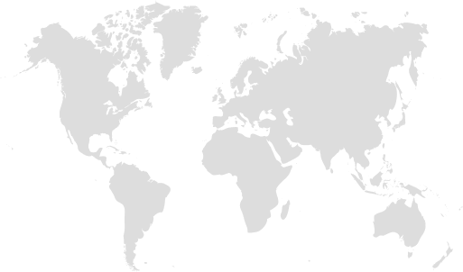
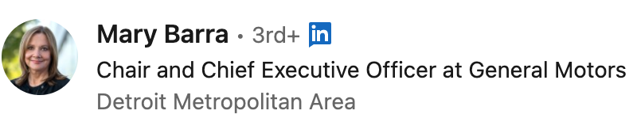
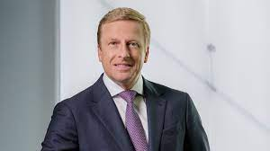
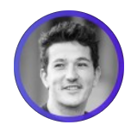
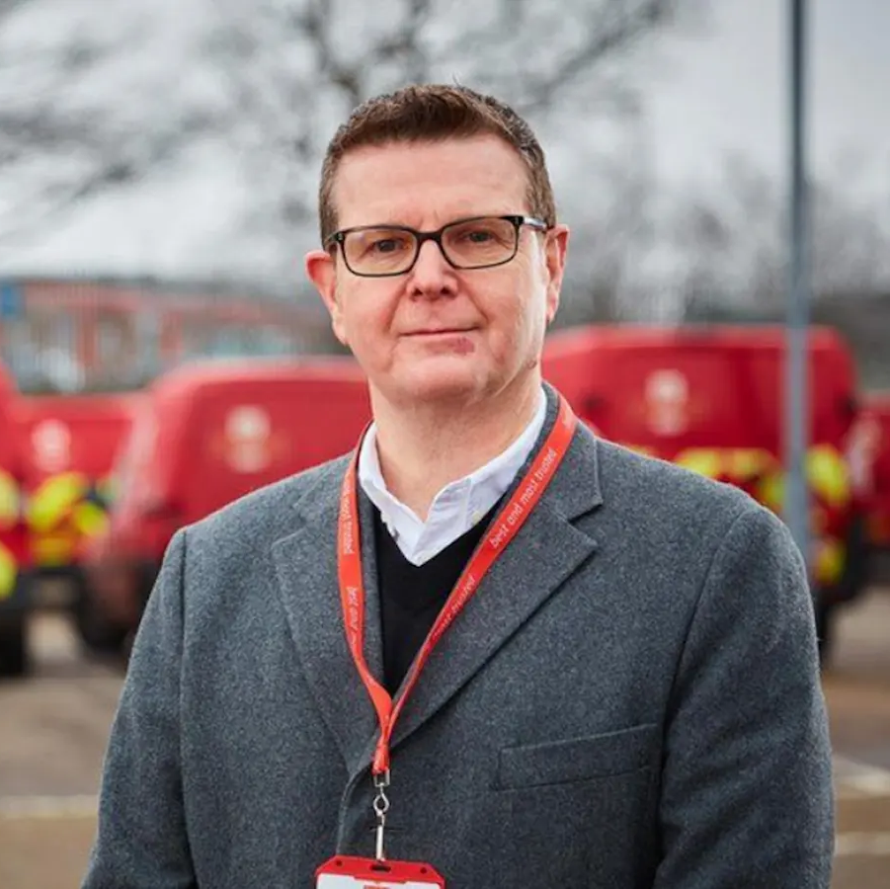
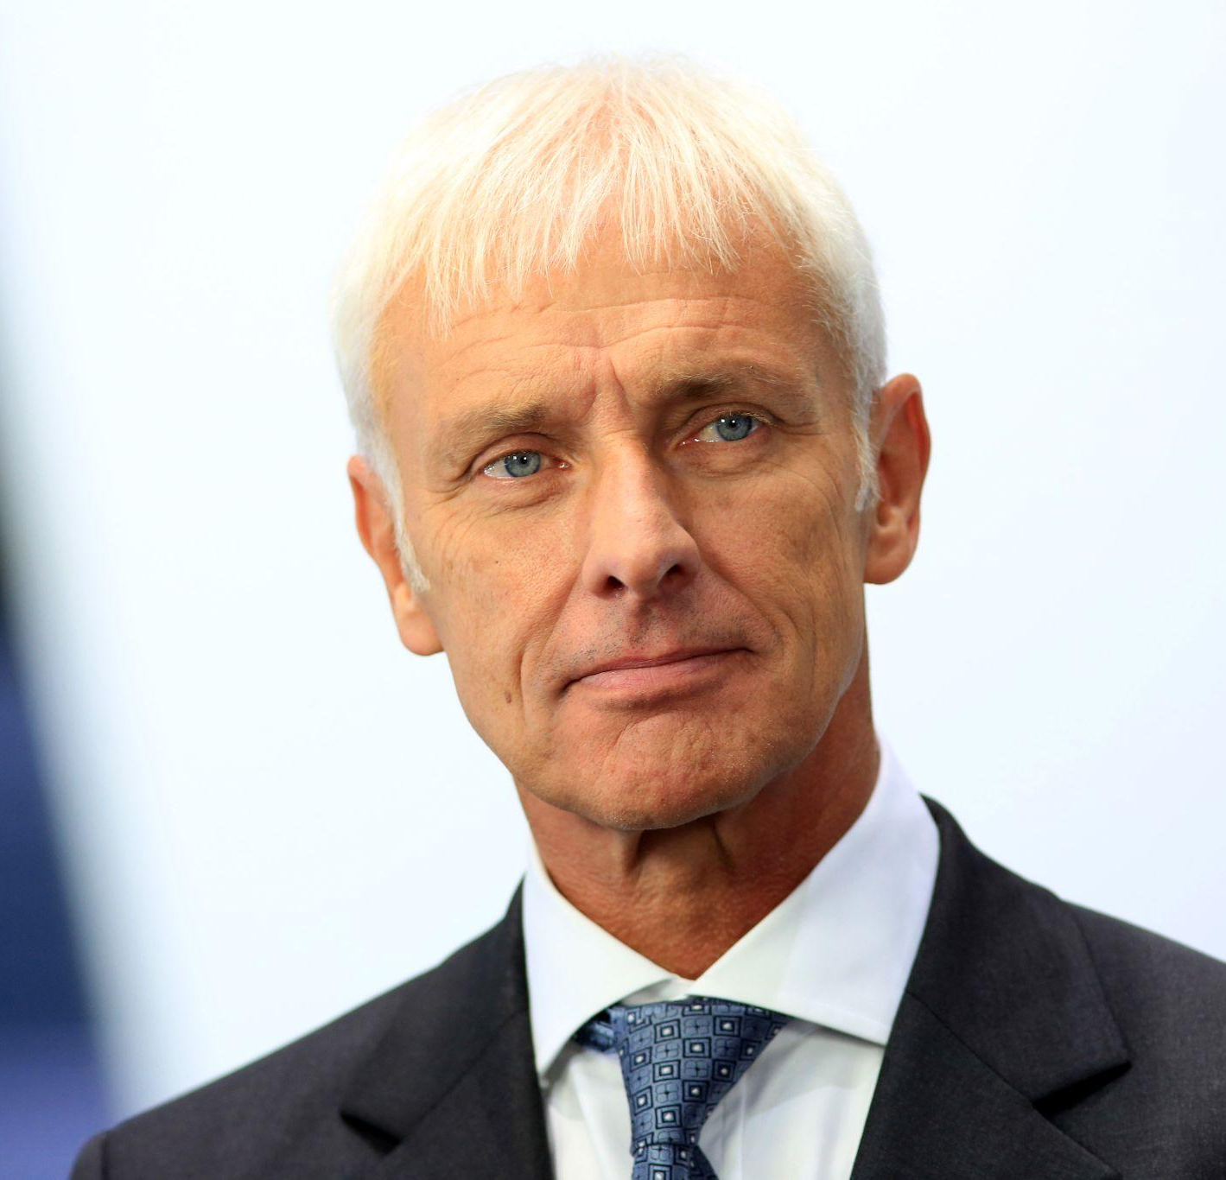
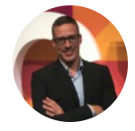
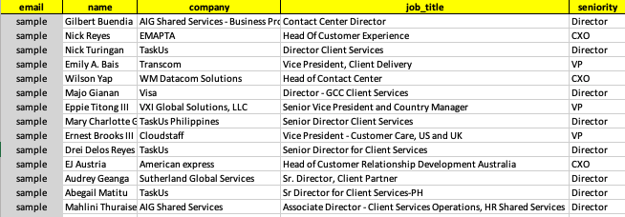
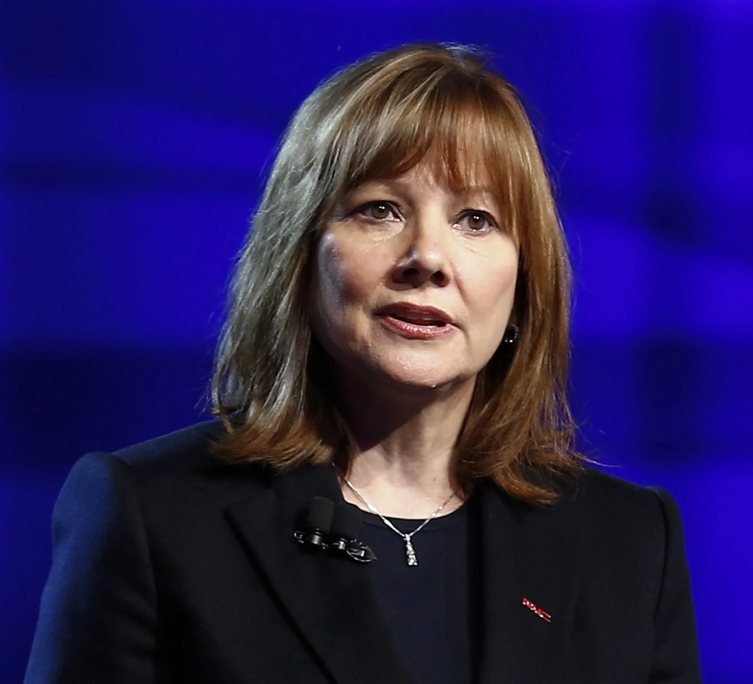
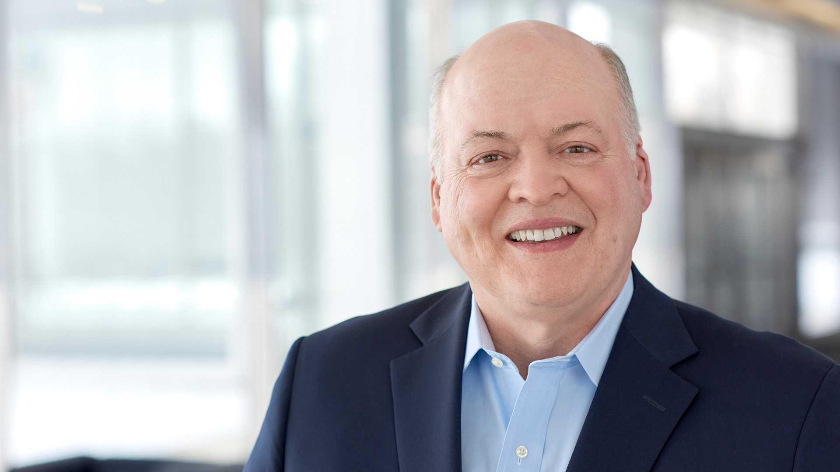
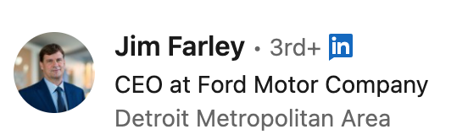
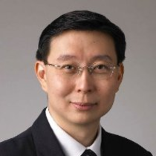
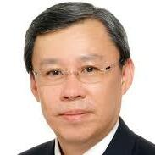
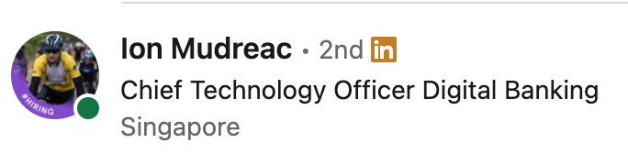

Slide 40
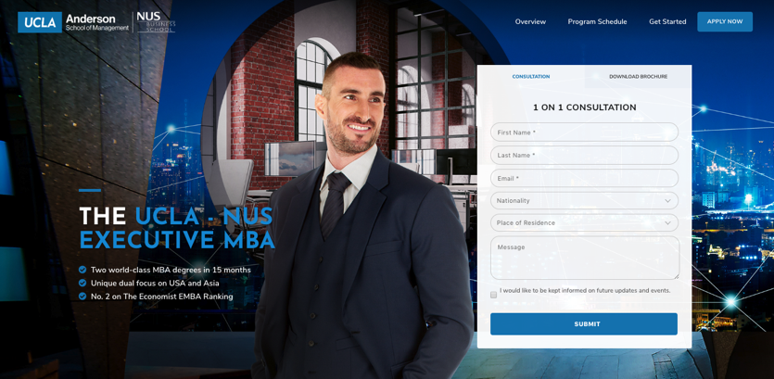
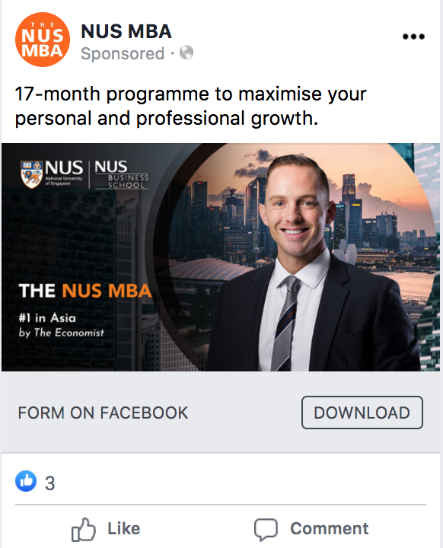
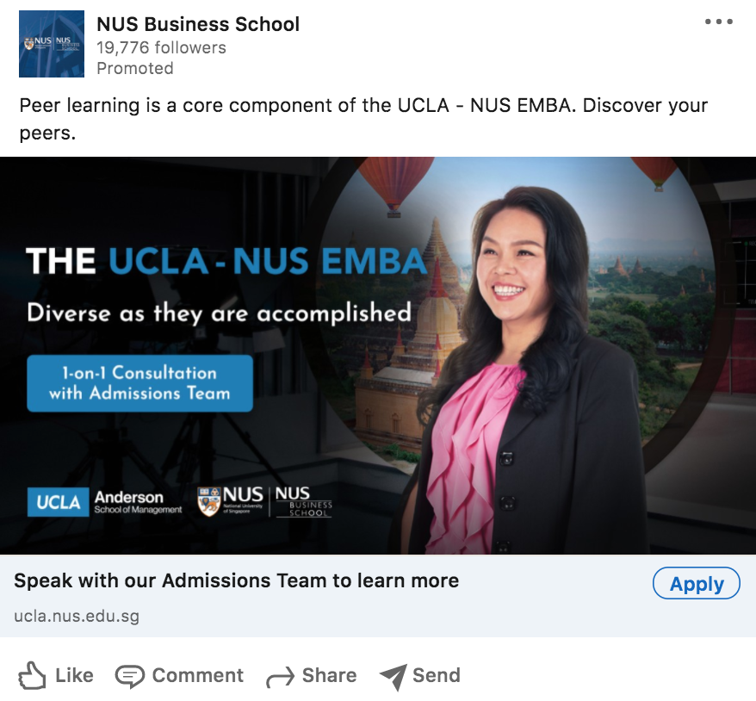
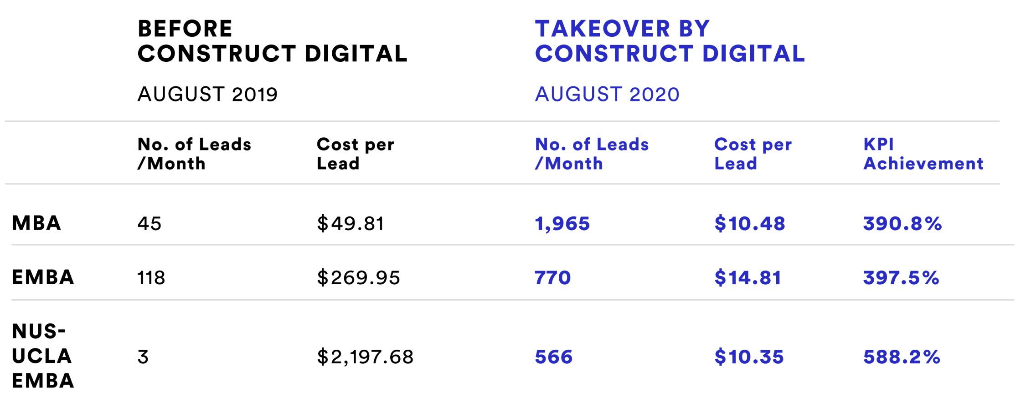

Slide 43




Slide 44




Slide 45




Slide 46




Slide 47




Slide 48




Slide 49




Slide 50



















Slide 51

















Thank You

Slide 52




















Slide 53





















Slide 54



















Slide 55











Slide 56











